Slide 1
Piano Music Transcription Based on Computer Vision
by
06118113 HaiMing Hsu 06018415 Pushen Zuo
2021/06/01

Slide 2
CONTENTS:
1· Literature Review
2· Method
3· Brief Analysis
4·Conclusion
5. Reference
DIVISION OF LABOR：
Haiming： Pressed key detection, Music score transcription, PPT and report
Pushen: Keyboard detection and transformation, Modules’ interconnection

Slide 3
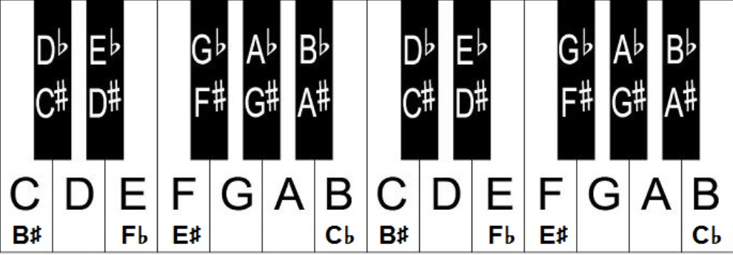
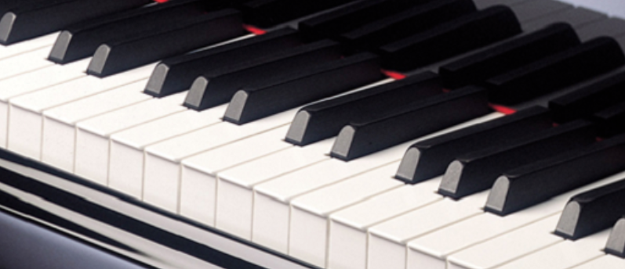
A brief introduction of the piano and the score
Most of pianos have 88 keys in total.
52 white and 36 black keys
Black keys are used for sharp‘#’ or flat‘b’ notes.
Fig1. Piano keyboard and notes diagram
Fig2. Part of the piano keyboard
Notes:
A Piano has two different kind of keys， the white keys and the blacks. Traditional pianos have 88 keys. Each key corresponds with a note.

Slide 4
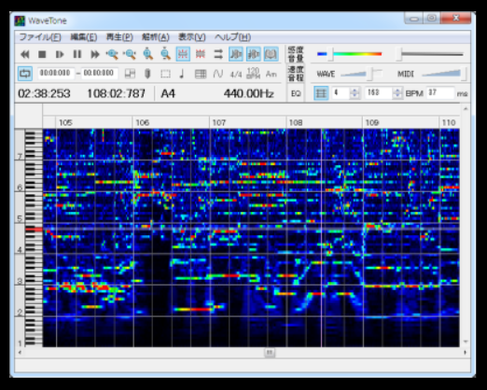
1 .Audio Signal Processing
Multiple F0 analysis
Method：we can divide music signal into time frames. And then we will transform the signal from time domain to frequency domain.
(STFT, constant-Q transform, etc.)
Difficulties：the harmonic frequency may disturb the recognition.
Fig5. WaveTone Software

Slide 5
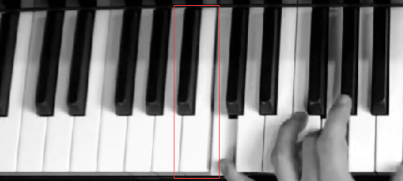
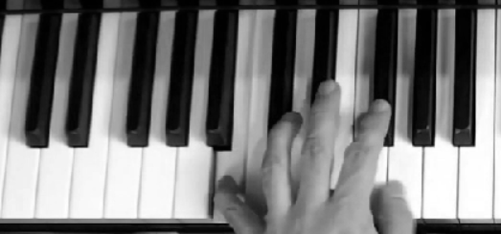
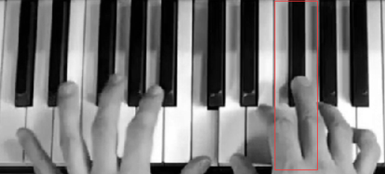
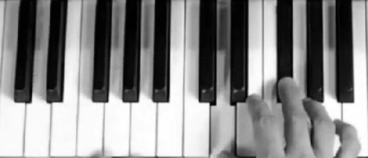
Our approach : Pure compute vision resolution * a replication actually
The principal is quite simple. It is literally all based on gray processing.
Thanks to the gray processing and its ability to enhance the light and shadow details,
it makes possible for easily distinguishing the foreground and background.

Slide 6
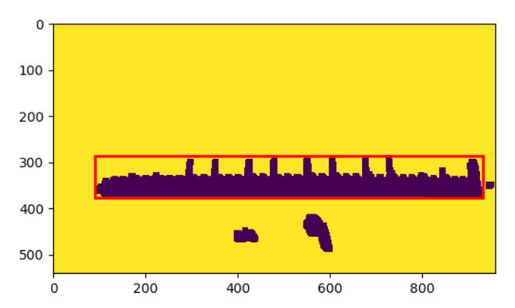

Keyboard detection and transformation
Get the maximum of the area of connected components
Perspective transformation
Get the vertex of the keyboard using linear programming
Perspective transformation
Get vertex

Slide 7
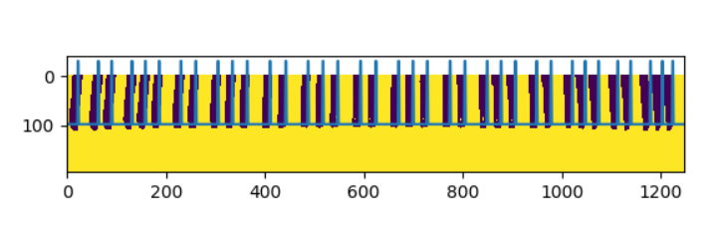
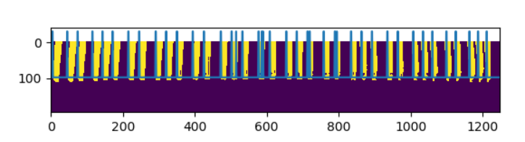
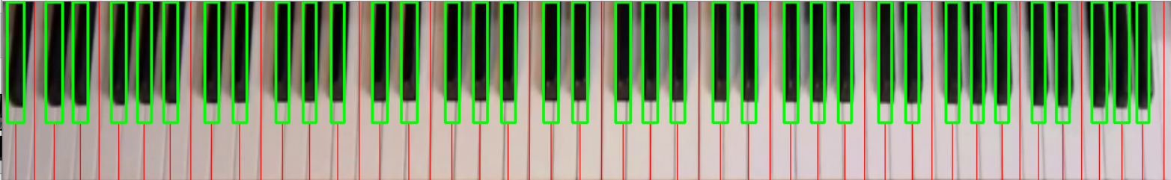
Get every key from the keyboard
Method: get gradient from the binary image

Slide 8
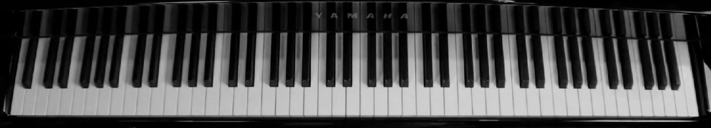
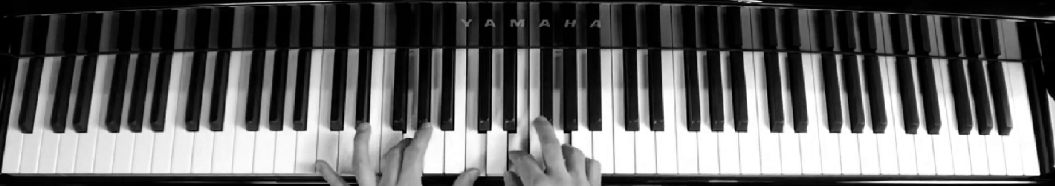
Pressed Key detection based on grayscale image
Background
Foreground

Slide 9

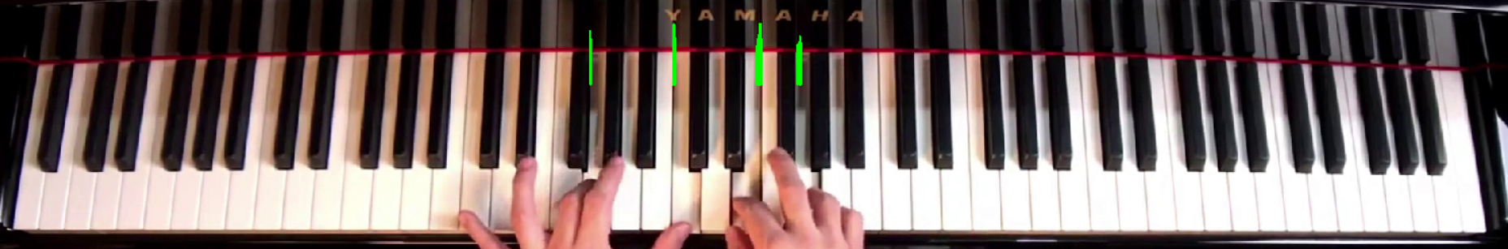
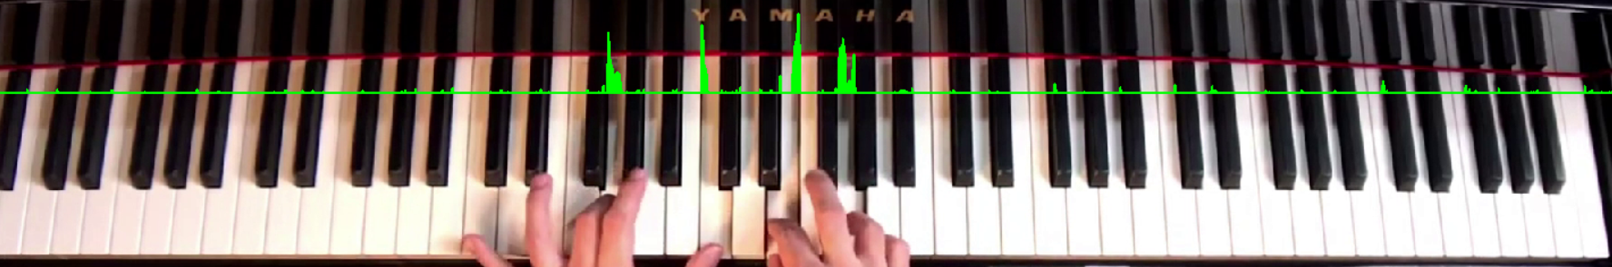
Pressed Key detection based on grayscale image
By subtraction , these distinction could be basically extracted
Background-Foreground
DetectLineHeightW=560
DetectThresholdW=50
By computing the gradient on a certain height, it shows as above
Two parameters are DetectLineHeightW (dominant) & DetectThresholdW

Slide 10
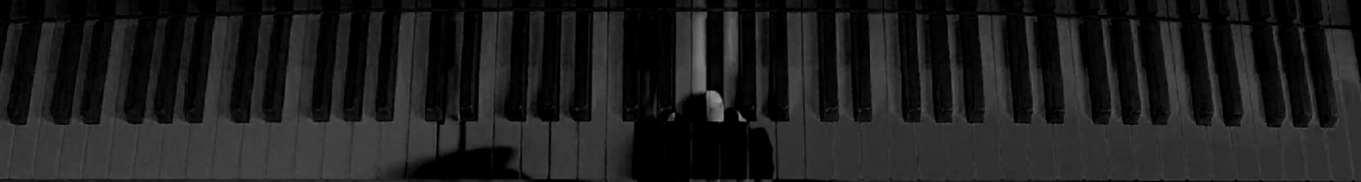
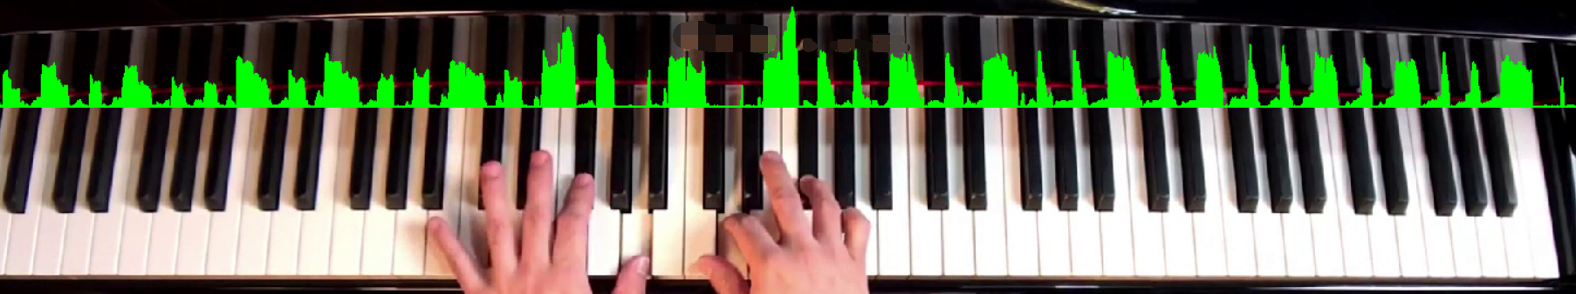
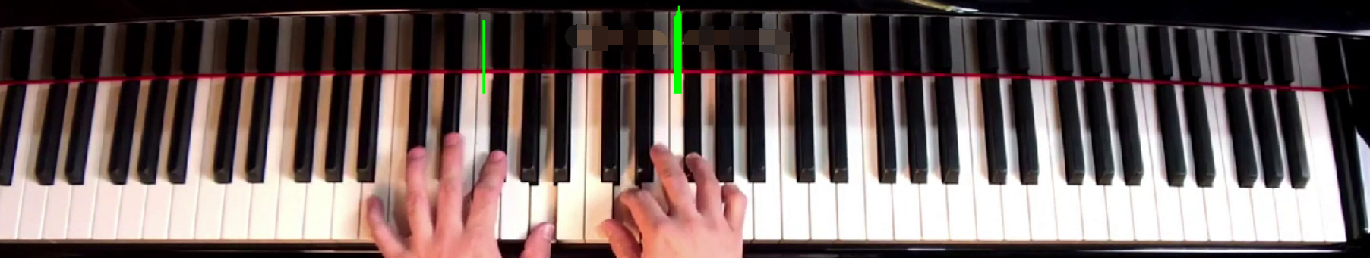
Pressed Key detection based on grayscale image
A parameter DetectLineHeightB
When it comes to black keys, the subtraction should be reversed.
Foreground-Background
DetectLineHeightB=545
DetectThresholdW=97
By computing the gradient on a certain height, it shows as above
Two parameters are DetectLineHeightB & DetectThresholdB (dominant) .
Fortunately, all parameters mentioned is not tedious to tune fine.

Slide 11

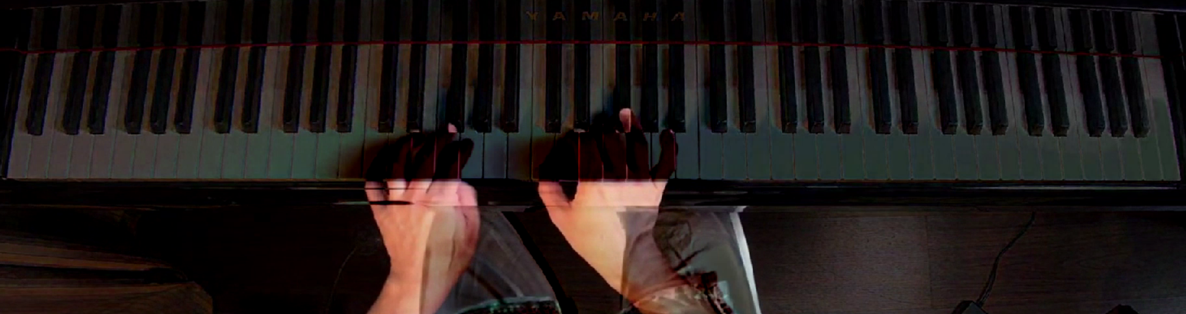
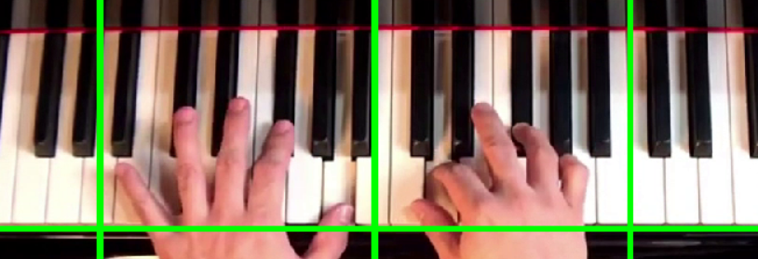
Hand detection
We apply the ycbcr skin color extraction and subtract the image with background to obtain the outcome below.
Preset edge of the key
Left margin line
Numerically half
right margin line

Slide 12
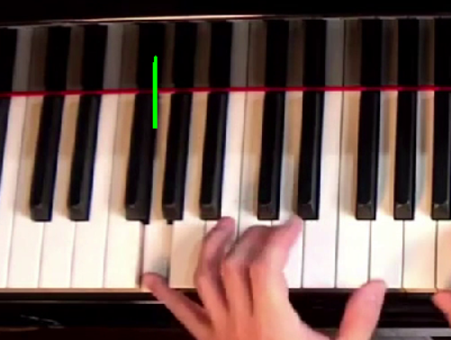
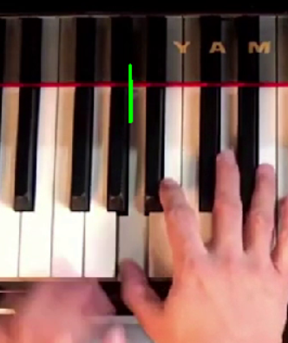
Pressed Key data processing
From many green lines to only one line
We may press the key for many continuous frames, so we need to get the first frame when the key is pressed.
Obtain the location of the lines in order to get the pressed keys
Time array(left), key number(right)

Slide 13


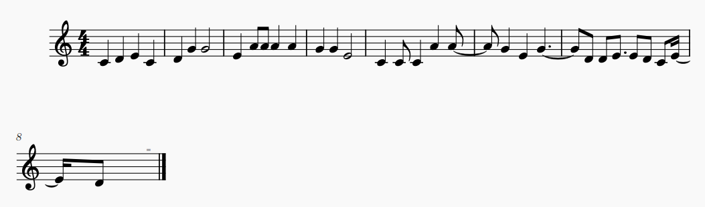
Score transcription
For music transcription, we call an open lib called music21.
dnotes=[1,3,5,[1,3,5]] time=[1,0.94,0.9375,0.9375]
Code and Dictionary
Xml file
dnotes=[0,1,2,0,1,4,4,2,5,5,5,5,4,4,2,0,0,0,5,5,4,2,4,1,1,2,2,1,0,2,1] time=[0.625,0.625,0.625,0.625,0.625,0.625,1.25,0.625,0.3125,0.3125,0.625,0.625,0.625,0.625,1.25,0.625,0.3125,0.625,0.625,0.625,0.625,0.625,1.25,0.3125,0.3125,0.5,0.3125,0.3125,0.3125,0.3125,0.3125]

Slide 14
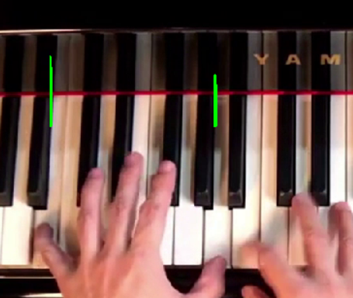
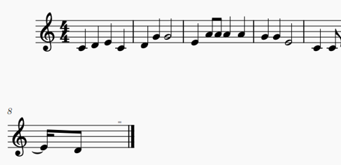
Accuracy
Hardware：Fps≈71 CPU Intel core i5-8265U 1.6GHz 1.8GHz
Wrong recognition：9
Total：251
Accuracy
（key recognition）：96.4%
Right notes transformation：524
Total：843
Accuracy
（music transform）：62.15%

Slide 15
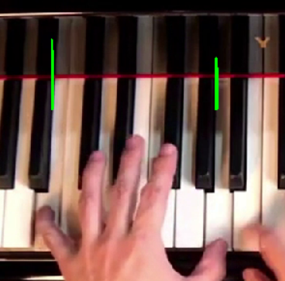
Something needs to be improved
The result of the recognition is good, but the accuracy of the music transformation is lower than we imagine.
The depth of the pressed key has an influence on the delay of the recognition of the key pression. The delay can contribute to the order error of the note.
Different placement of the keyboard can change the parameter of the function, even the step or method.

Slide 16
XHM：
At first, we apply the binarization to the image after the gray processing.
As a result, we lost the light and shadow’s information.
The outcome is not ideal and hard to tune fine.
After deleting the binarization, only with the grayscale images, the outcome proves to be better.
We realize that the light and shadow are significant factors in image processing.
Humans are high sensitive to these two information.
We tend to obtain more information in grayscale images than color images when we process them.
ZPS：
I have a chance to design a large computer vision program to solve a problem from our daily life. I understand the OpenCV function through the continuous attempt in the program.
Reading paper is a good way to get an appropriate method to solve the problem.

Slide 17
Fig 1,2 ：Mantius Cazaubon, “Piano notes”&”cover”, Piano Keyboard Guide,2012 http://www.piano-keyboard-guide.com/piano-notes.html
Reference:
M. Akbari and H. Cheng,” Real-Time Piano Music Transcription Based on Computer Vision”, IEEE TRANSACTIONS ON MULTIMEDIA, VOL. 17, NO. 12, DECEMBER 2015
claVision：
https://core.ac.uk/reader/185287370

Slide 18
Thanks for listening~

